Slide 1






Lecture 16:
Error Handling
Course - Web Development - II
-By
Instructor Name
Pratik Raj verma
‹#›
welcome@krmangalam.edu.in
Sohna Road,Gurugram,Haryana 122103

Slide 2

| Table of Contents
Error Handling
References.
The End.
‹#›

Slide 3
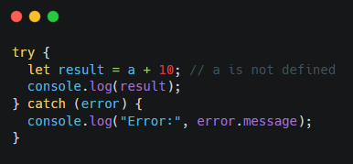
| Error Handling
1. try...catch (Definition)
try...catch is a JavaScript statement used to handle runtime errors. The code that may cause an error is written inside the try block.
If an error occurs, JavaScript stops execution of the try block and moves to the catch block, preventing the program from crashing.
‹#›

Slide 4
| Error Handling
Key Points of try...catch
Used to handle runtime errors
Prevents application crash
catch receives an Error object
Commonly used with async/await
‹#›

Slide 5
| Error Handling
2. Error Handling with fetch()
fetch() is a Web API used to make HTTP requests. The promise returned by fetch() only rejects when there is a network error (for example, no internet connection)
Important: fetch() does not reject the promise for HTTP error status codes like:
404 (Not Found)
500 (Internal Server Error)
HTTP Error Handling in fetch
‹#›

Slide 6
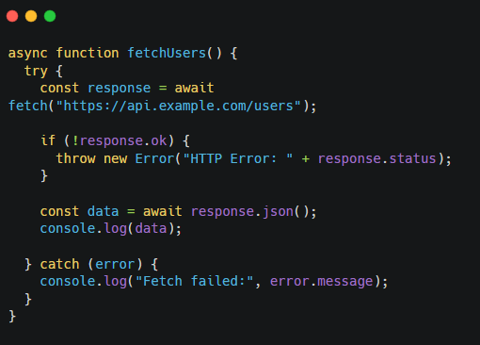
| Error Handling
HTTP Error Handling in fetch
To detect HTTP errors, we must manually check the response.
response.ok (Definition)
response.ok is a boolean value:
true → status code is between 200–299
false → request failed
Even if the server sends an error response (like 404), fetch() still resolves the promise. So we manually throw an error using:
throw new Error("message");
This forces control to move into the catch block.
‹#›

Slide 7

| Check Your Understanding
Question : What is the main purpose of try...catch in JavaScript?
Options : A. To stop program execution
B. To handle runtime errors and prevent app crash
C. To write asynchronous code
D. To improve performance
Answer : B. To handle runtime errors and prevent app crash
Explanation:
try...catch catches runtime errors and prevents the program from crashing.
‹#›

Slide 8
| Check Your Understanding
Question : When does the promise returned by fetch() reject?
Options : A. When the server returns 404
B. When the server returns 500
C. When there is a network error
D. When response.ok is false
Answer : C. When there is a network error
Explanation:
fetch() rejects only on network failures, not on HTTP status errors.
‹#›

Slide 9
| Check Your Understanding
Question : Which property should be checked to handle HTTP errors in fetch()?
Options : A. response.error
B. response.statusText
C. response.ok
D. response.fail
Answer : C. response.ok
Explanation:
response.ok tells whether the HTTP status code is successful (200–299).
‹#›

Slide 10
| References
MDN Web Docs : Comprehensive and official documentation for JS. 🔗https://developer.mozilla.org/en-US/docs/Web/JavaScript
W3Schools – JS Tutorial : Beginner-friendly JS tutorials with examples and interactive editors. 🔗 https://www.w3schools.com/js/
JavaScript.info - A comprehensive tutorial-style website that covers core JavaScript concepts in depth.
🔗https://javascript.info/
‹#›

Slide 11
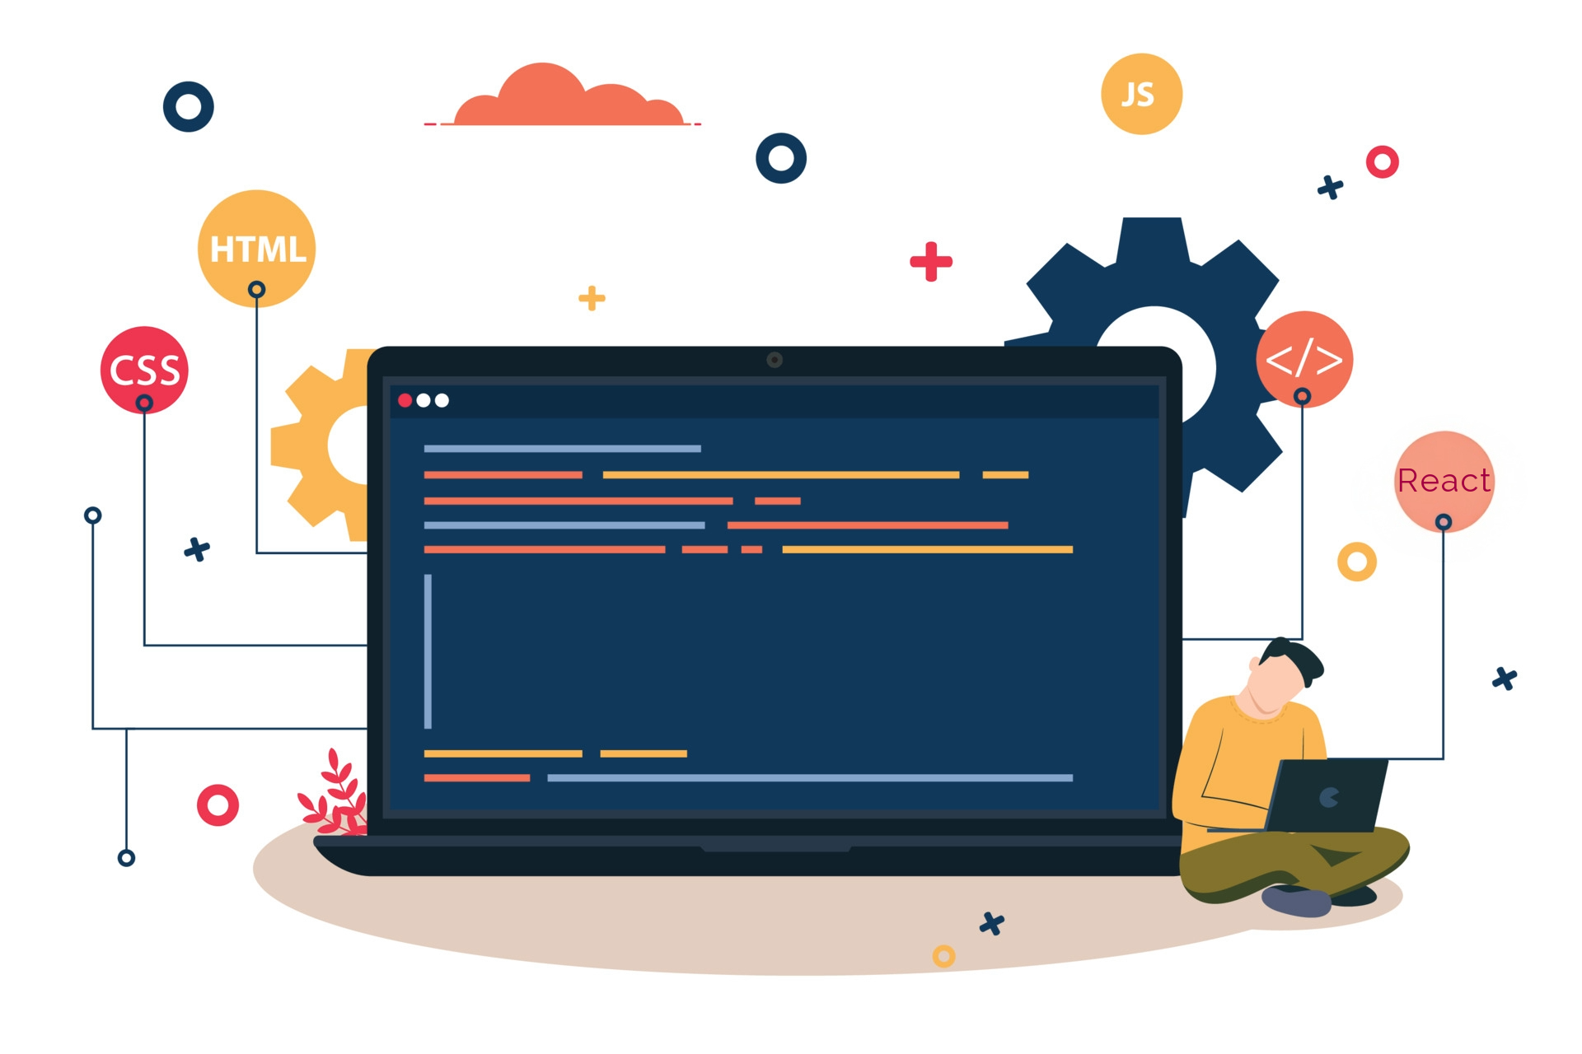
Thanks
For
Watching
Course - Web Development - II
‹#›
welcome@krmangalam.edu.in
Sohna Road,Gurugram,Haryana 122103

